Slide 1

WORKOUT TRACKER
Task - 1

Slide 2

YourꢀProjectꢀName
▪
YourꢀProjectꢀIntroduction
LMS Username
Name
Batch

Slide 3
Introduction Purpose:
Physical activity increased in the fitness tracker groups compared to the control group.
Moderate physical activity and autonomy need satisfaction increased in the ENT group. Identified motivation decreased in the ET and control groups and introjected motivation decreased in the control group. Amotivation increased in the ENT group.
Conclusively, self-tracking via fitness apps can support physical activity, and
normalized step targets can undermine motivation.

Slide 4
Document Conversions:
Entire document should be justified.
Convention for Main title
Font face: Times New Roman
Font style: Bold
Font Size: 14
Convention for Sub title
Font face: Times New Roman
Font style: Bold
Font Size: 12
Convention for body
Font face: Times New Roman
Font Size: 12

Slide 5
Scope of Development Project:
In sport and exercise psychology, the effects of fitness app usage have been subject to a growing body of studies (Romeo, 2019; Schoeppe et al., 2016). It has been shown that fitness app usage can promote higher activity levels, such as step counts (Glynn et al., 2014;Goodyear et al., 2017; Stawarz, Cox, & Blandford, 2015).
Reviewing the efficacy of fitness app based interventions, Schoeppe et al. (2016) found that improvements in physical activity were observed in 14 out of 21 studies.
In a meta-analysis targeting RCT studies with objective. Measures of physical activity, it was found that the step count did not increase in fitness app users compared to controls.

Slide 6
Definitions, Acronyms and Abbreviations:
JAVA -> platform independence
SQL-> Structured query Language
ER-> Entity Relationship
UML -> Unified Modeling Language
IDE-> Integrated Development Environment
SRS-> Software Requirement Specification

Slide 7
References:
Books:
Abrantes, A. M., Blevins, C. E., Battle, C. L., Read, J. P., Gordon, A. L., & Stein, M. D. (2017). Developing a Fitbit-supported lifestyle physical activity intervention for depressed alcohol dependent women. Journal of Substance Abuse Treatment. Mental Health, 3(1), e7. Bouchard, C., Blair, S. N., & Haskell, W. L. (2018). Physical activity and health. Human Kinetics,Busch, L. (2019). T
Websites:
http://www.slideshare.net/
http://code.google.com/p/cse435-group6/

Slide 8
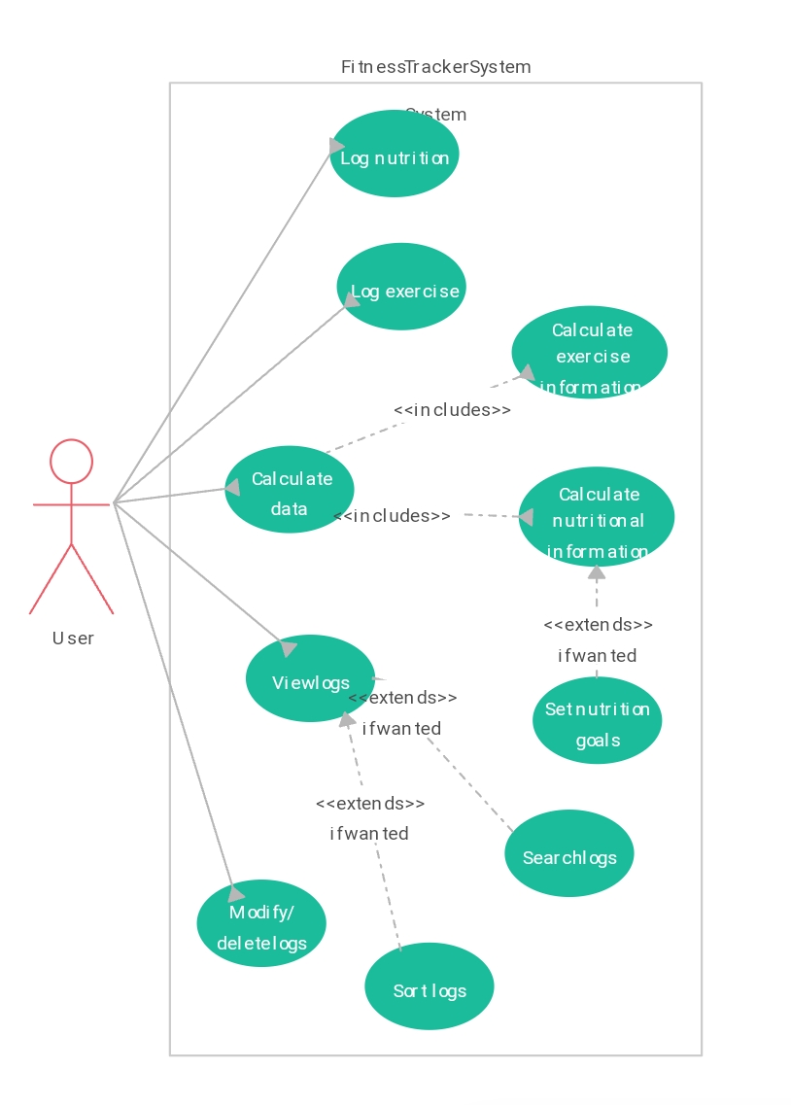
Overall Descriptions Product Perspective: Use diagram of workout tracker application

Slide 9
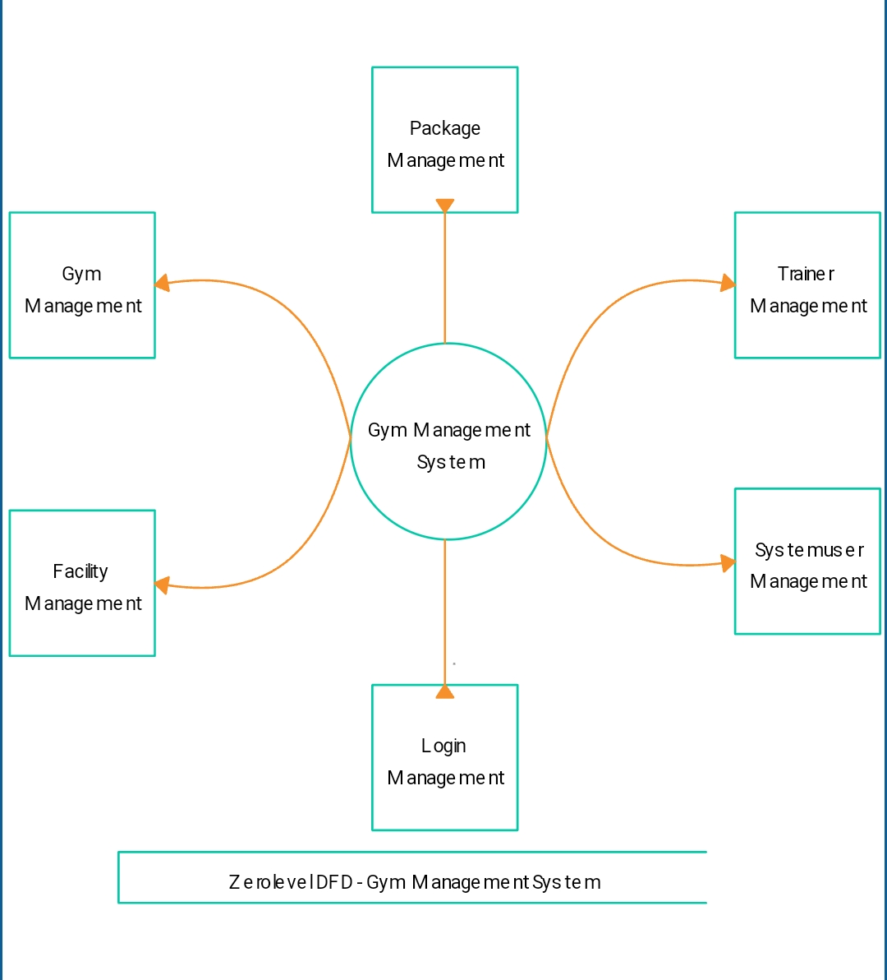
Product Function:

Slide 10
User Classes and Characteristics:
User characteristics of workout tracker application refer to the traits and behaviors of the individuals who interact with and make the tracking of the fitness by the workout.
Some key user characteristics include:
1.Tracking workouts
2.Counting steps
3. Monitoring heart rate
4.Providing nutrition information
5.Setting fitness goals.

Slide 11
Operating Environment:
The product will be operating in windows environment. The Library Management System is a website and shall operate in all famous browsers, for a model we are taking Microsoft Internet Explorer, Google Chrome ,& Mozilla Firefox.
Also it will be compatible with the IE 6.0. Most of the features will be compatible with the Mozilla Firefox & Opera 7.0 or higher version.
The only requirement to use this online product would be the internet connection.
The hardware configuration include Hard Disk: 40 GB, Monitor: 15” Color monitor, Keyboard: 122 keys.
The basic input devices required are keyboard, mouse and output devices are monitor, printer etc.

Slide 12
Assumptions and Dependencies: The assumptions are:- * The coding should be error free. * The system should be user-friendly so that it is easy to use for the users. * The information of all users, books and libraries must be stored in a database that is accessible by the website. *The system should have more storage capacity and provide fast access to the database. * The system should provide search facility and support quick transactions. * The Library System is running 24 hours a day. * Users may access from any computer that has Internet browsing capabilities & a Pillai Institute of Information Technology, Engineering, Media Studies & Research Department of Information Technology Internet connection. *Users must have their correct usernames and passwords to enter into their online accounts and do actions.

Slide 13
Software Configuration:- This software package is developed using java as front end which is supported by sun micro system. Microsoft SQL Server as the back end to store the database. Operating System: Windows NT, windows 98, Windows XP Language: PHP, JavaScript, Python, Java, Net beans 7.0.1 (front end). Database: MS SQL Server (back end). Hardware Configuration:- Processor: Pentium(R)Dual-core CPU. Hard Disk: 40GB. RAM: 256 MB or more.

Slide 14
Data Requirement: Furthermore, decreases in specific forms of motivation were found in the ET and control groups in this study. Specifically, decreases in identified motivation were found in the ET and the control groups, and a decrease in introjected motivation was found in the control group. In this context, it has been meta-analysed that autonomous forms of motivation (i.e., internal and identified motivation) can lead to enhanced physical health, such as physical activity, and mental health (Ng et al., 2012) External Interface Requirement: This was important for ethical reasons as fitness app usage includes the disclosure of personal data. In this scenario, however, it was expected that the group not being provided with a fitness tracker could have perceived inferiority to the participants who were provided with fitness tracker groups, potentially leading to undesired and hardly controllable group effects.

Slide 15
System Features: Tracking:- Most fitness trackers track number of steps taken, heart rate, and sleep patterns. System:- Some also have connected apps that allow you track your overall progress, set goals as well as offer guidelines to help you achieve your fitness goals. Benefits:- Some of the most common brands of fitness trackers are FitBit, Garmin and Jawbone.

Slide 16
Other Non-Functional Requirements: 1. Complimentary:- As group differences referring to age and education were found in the preliminary analyses, all analyses were conducted again, entering age, education status, and student status as covariates. 2. Motivation:- Also, a significant time-group interaction effect was found. No group effect was found. For extrinsic motivation, no time, group, or time-group interaction effects were found. 3.Satisfaction:- However, no time-group-interaction effect was observed. With regards to competence, no significant group, time, or time-group interaction effects were found. 4.Strength and limitations:- Therefore, to control for potential effects, we conducted additional analyses entering these variables as covariates.

Slide 17
Other Requirements: 1. Target:- Using the well-established SDT as a theoretical framework, it was the aim of this study to investigate the effects of healthcare technology, specifically a fitness app and wearable. 2.Regulation:- The Implementation of a normalized health target on basic needs satisfaction, motivation and health behaviour (i.e., physical activity). 3.Implementation:- It was hypothesized that the implementation of a fitness app and wearable to support physical activity tracking has a positive effect on physical activity. 4.Scheduling:-(Hypothesis) It was hypothesized that the implementation of a normalized step target (i.e., 10,000 steps per day) would result in decreased levels of autonomy need satisfaction, autonomous motivation, and in increased levels of controlled motivation and a motivation compared to no implementation of such targets.

Slide 18
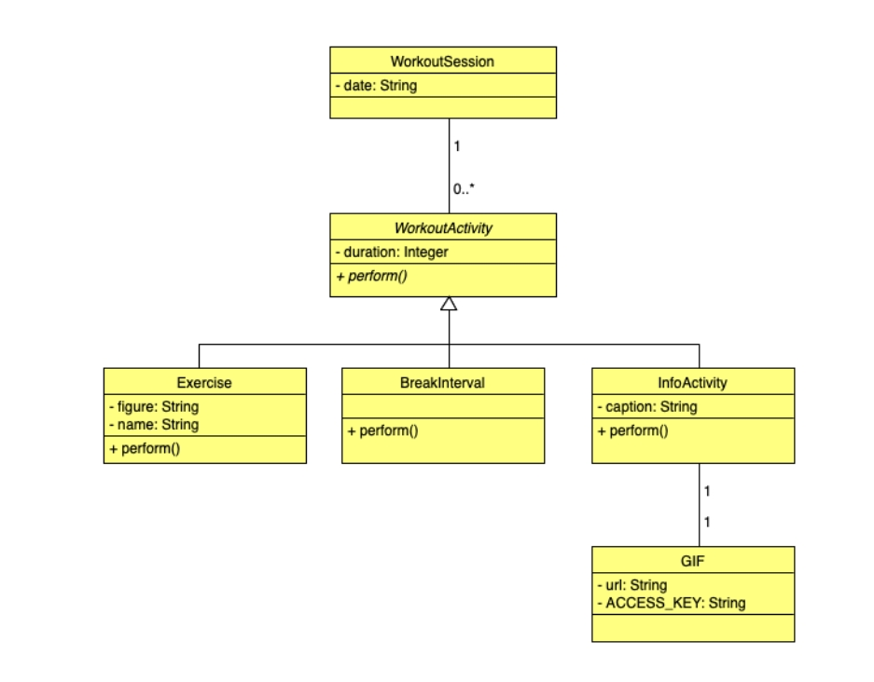
CLASS DIADRAM

Slide 19

Submission Github
https://github.com/Duraipandicse13/NM-SPCET-CSE-GROUP6/upload/main

Slide 20


